Slide 1
BMD ENG 301 Quantitative Systems Physiology (Nervous System)
Lecture 2: Neuroanatomy
2022_v1
Professor Malcolm MacIver

Slide 2
Quick announcements
Tuesday section 11-12
Aim for each section to be 24
We need 16 hands to go up to shift (at 1:40pm), of which 6 needs to be from the Friday section, and 11 needs to be from Tuesday section)

Slide 3
If you want to study the brain …
Classical Neuroanatomy
Functional Neuroanatomy
In vivo Modern Brain Imaging

Slide 4
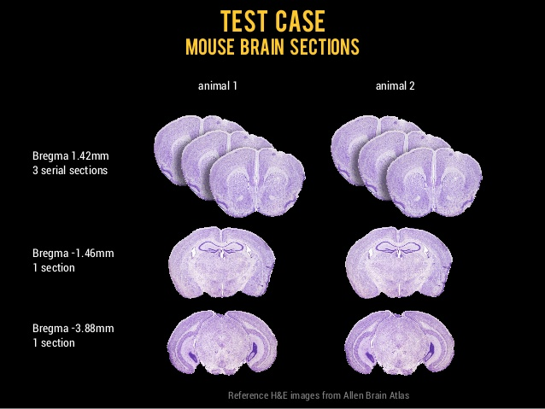
Classical Neuroanatomy

Slide 5
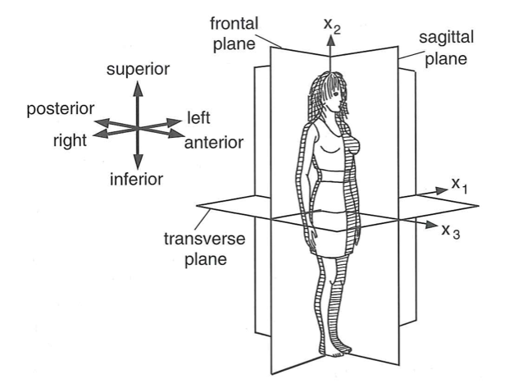

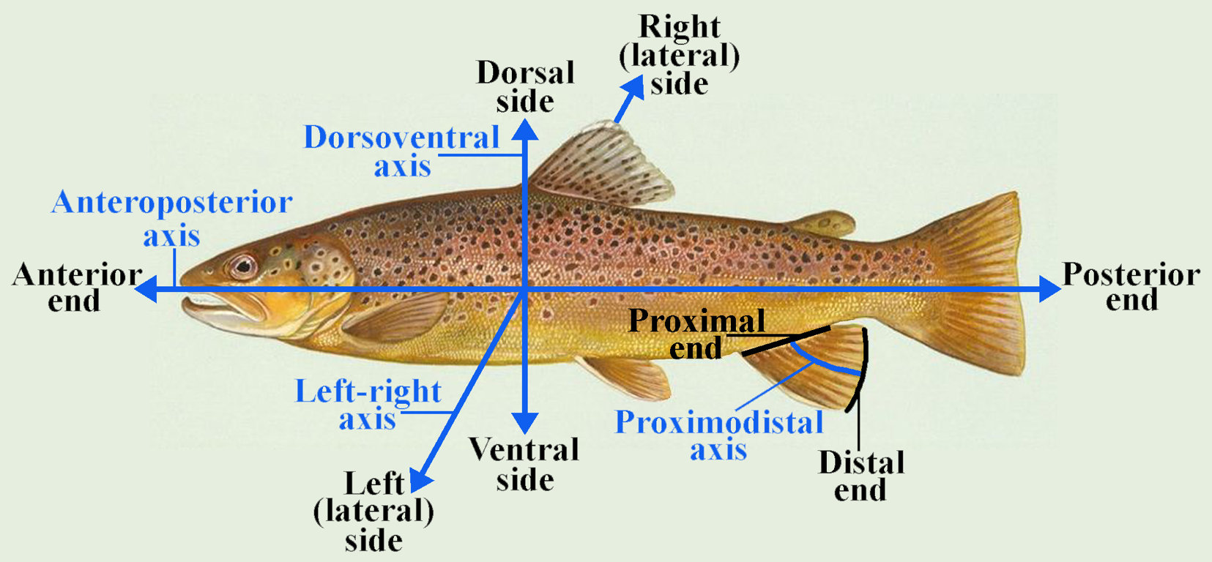
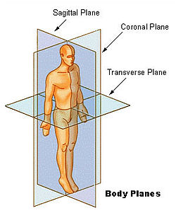
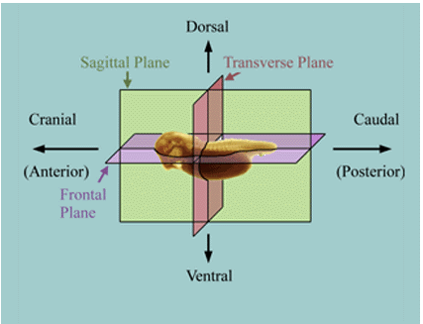
Note: Not in textbook
terms of location
Vertebrates
(all non-human animals)
terms of location
humans

Slide 6
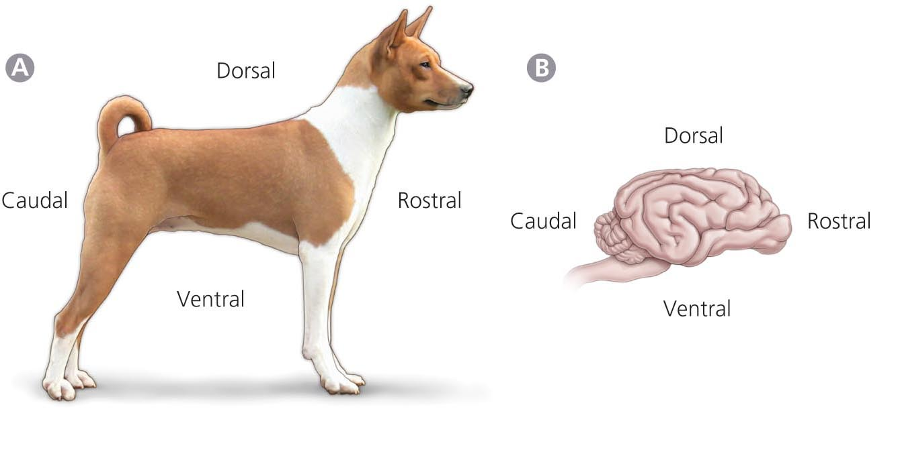
Neuroanatomical Nomenclature – Orientation terms
Fig. 1.2

Slide 7
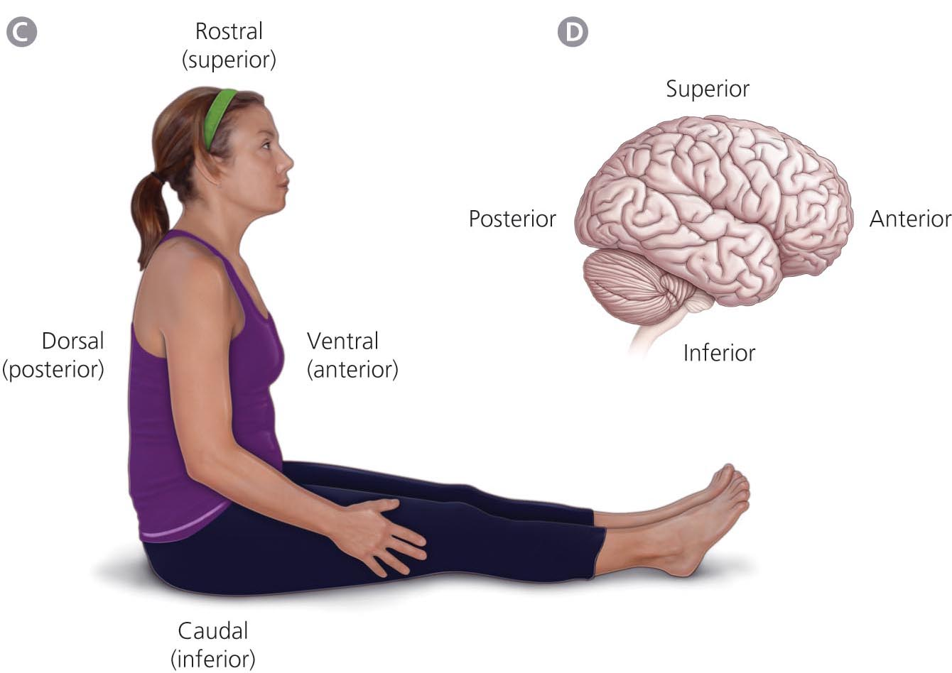
Human bodies & brains require different orientation terms
Fig. 1.2
Notes:
The terms “superior” and “inferior” are used in humans to indicate “toward the top of the head” and “toward the buttocks” in humans
“Posterior” and “anterior” in humans do not correspond to “caudal” and “rostral” as they do in non-humans

Slide 8
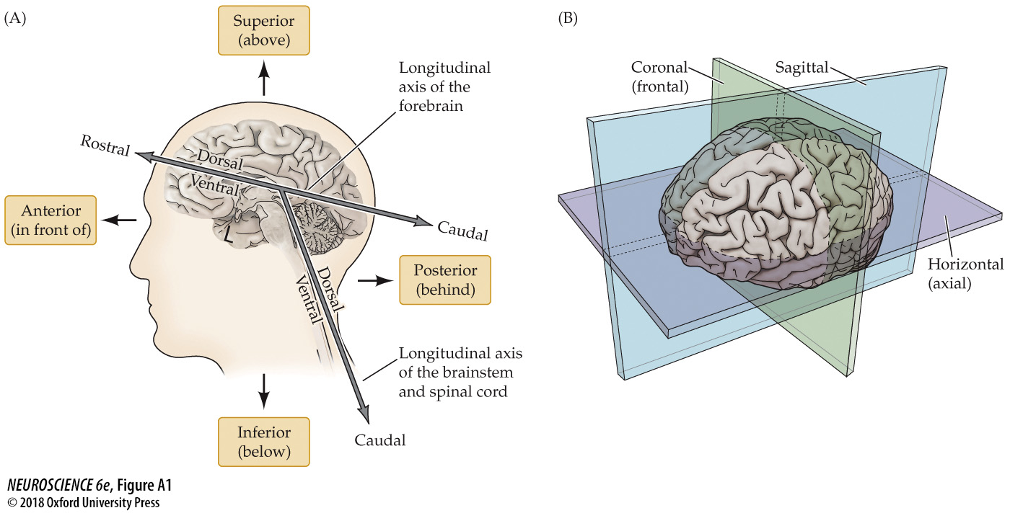
Notes:
FIGURE A1 Axes of the human nervous system. A flexure in the long axis of the nervous system arose as humans evolved upright posture, leading to an approximately 120° angle between the long axis of the brainstem and that of the forebrain. The consequences of this flexure for anatomical terminology are indicated in (A). The terms anterior, posterior, superior, and inferior refer to the long axis of the body, which is straight. Therefore, these terms indicate the same direction for both the forebrain and the brainstem. In contrast, the terms dorsal, ventral, rostral, and caudal refer to the long axis of the CNS. The dorsal direction is toward the back for the brainstem and spinal cord, but toward the top of the head for the forebrain. The opposite direction is ventral. The rostral direction is toward the top of the head for the brainstem and spinal cord, but toward the face for the forebrain. The opposite direction is caudal. (B) The major planes of section used in cutting or imaging the brain.

Slide 9
Brodmann Areas

Slide 10
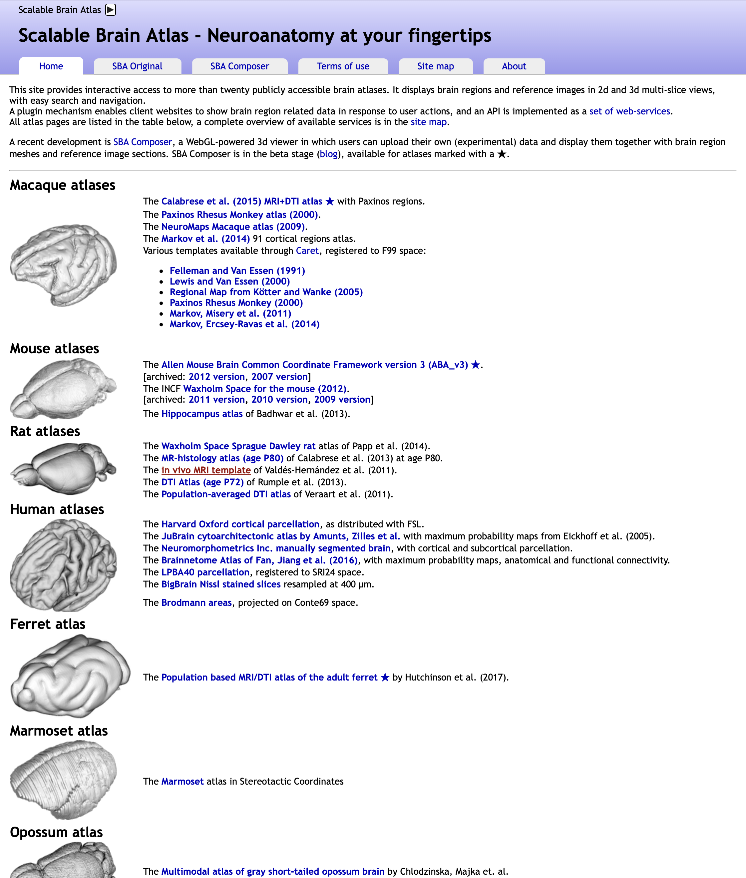
Online resource
https://scalablebrainatlas.incf.org

Slide 11
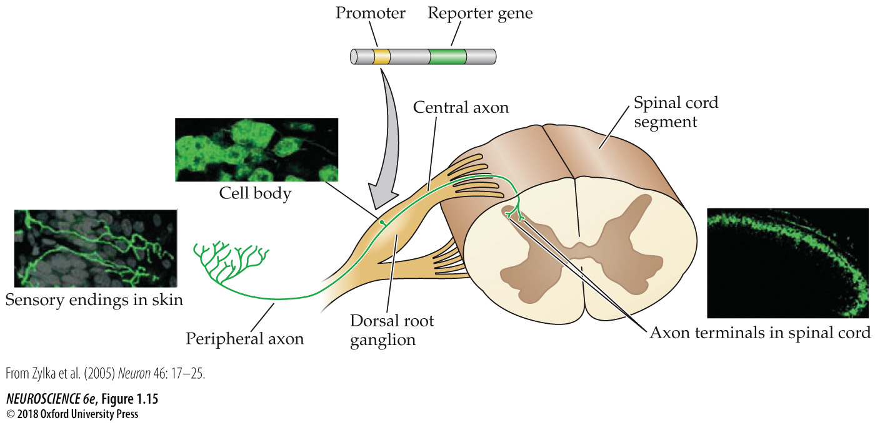
Tracing Pathways

Slide 12
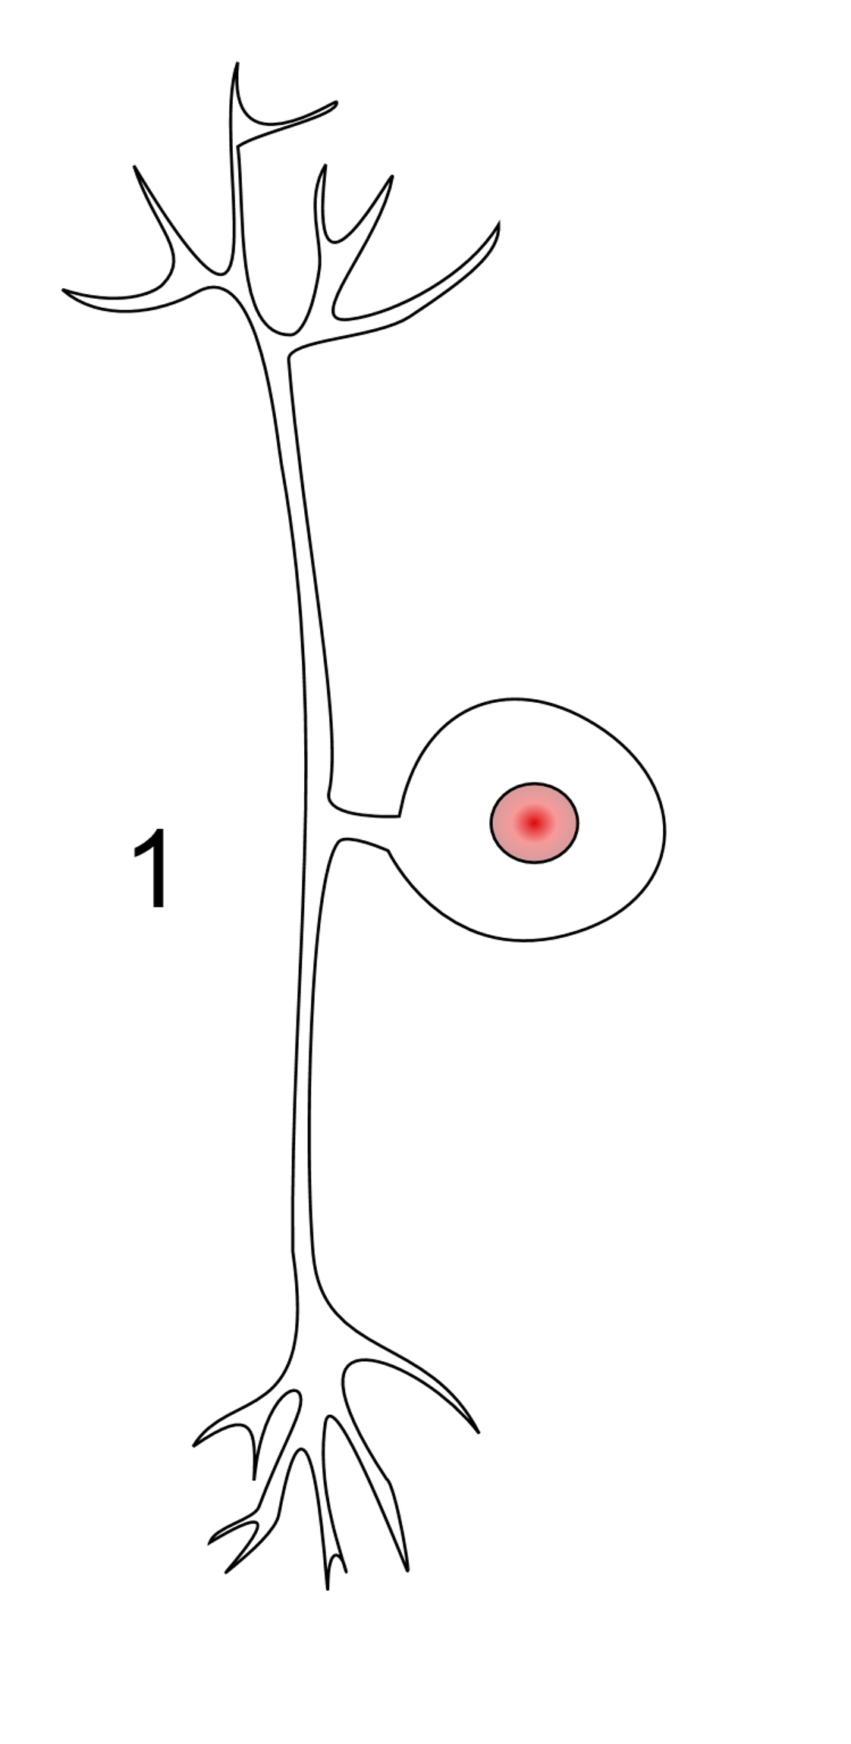
The psuedounipolar neuron
Most sensory afferent neurons are pseudounipolar…. Pseudounipolar neurons have one projection from the cell body, which splits into two axons: one that extends into the periphery and one that extends into the central nervous system.
Afferents that project into the spinal cord from skin and muscle are typically pseudounipolar. The cell bodies of these afferents are located in the dorsal root ganglia near the spinal cord…. The peripheral branch extends through a peripheral nerve, and is part of the sensory receptor in skin or muscle. The central branch projects through the dorsal (posterior) root into the spinal cord, and terminates on interneurons or motoneurons in the spinal cord, and may even project to the brainstem.
From: http://pittmedneuro.com/neuron.html

Slide 13
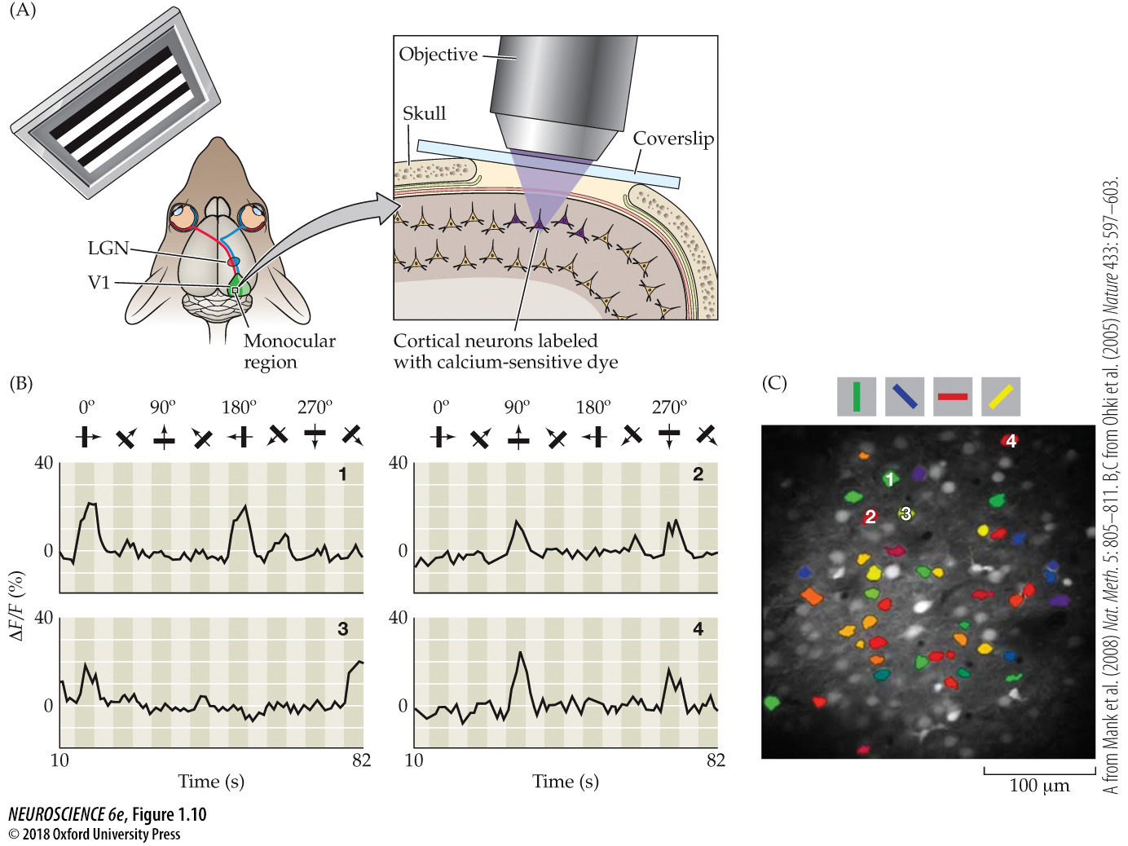
Functional Neuroanatomy

Slide 14
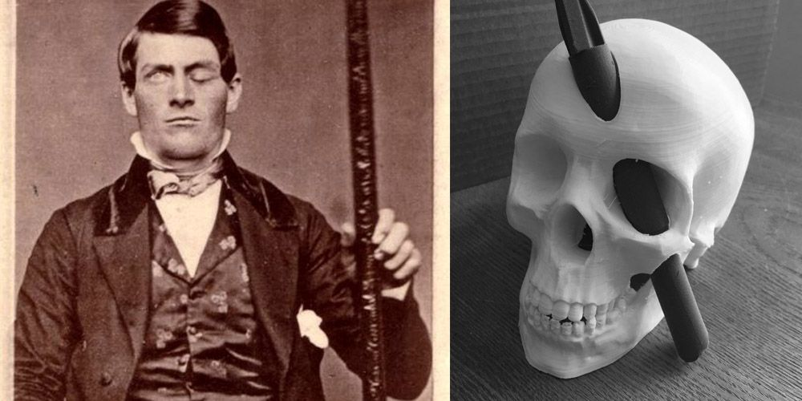
Functional Neuroanatomy
Phinaes Gage

Slide 15
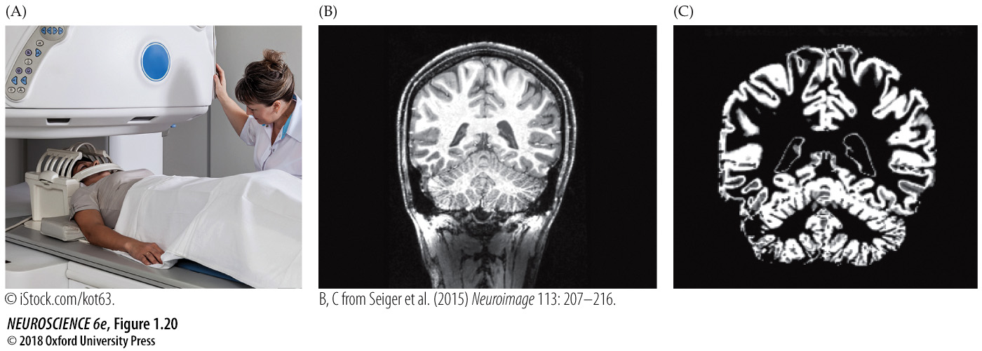
In vivo Structural Brain Imaging

Slide 16
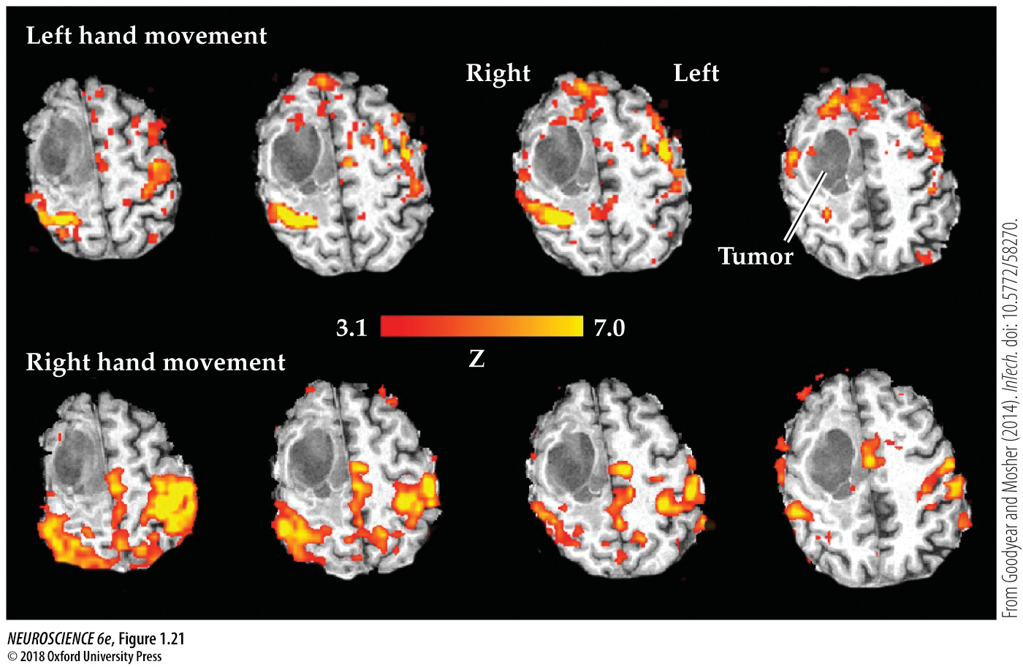
In vivo Functional Brain Imaging

Slide 17
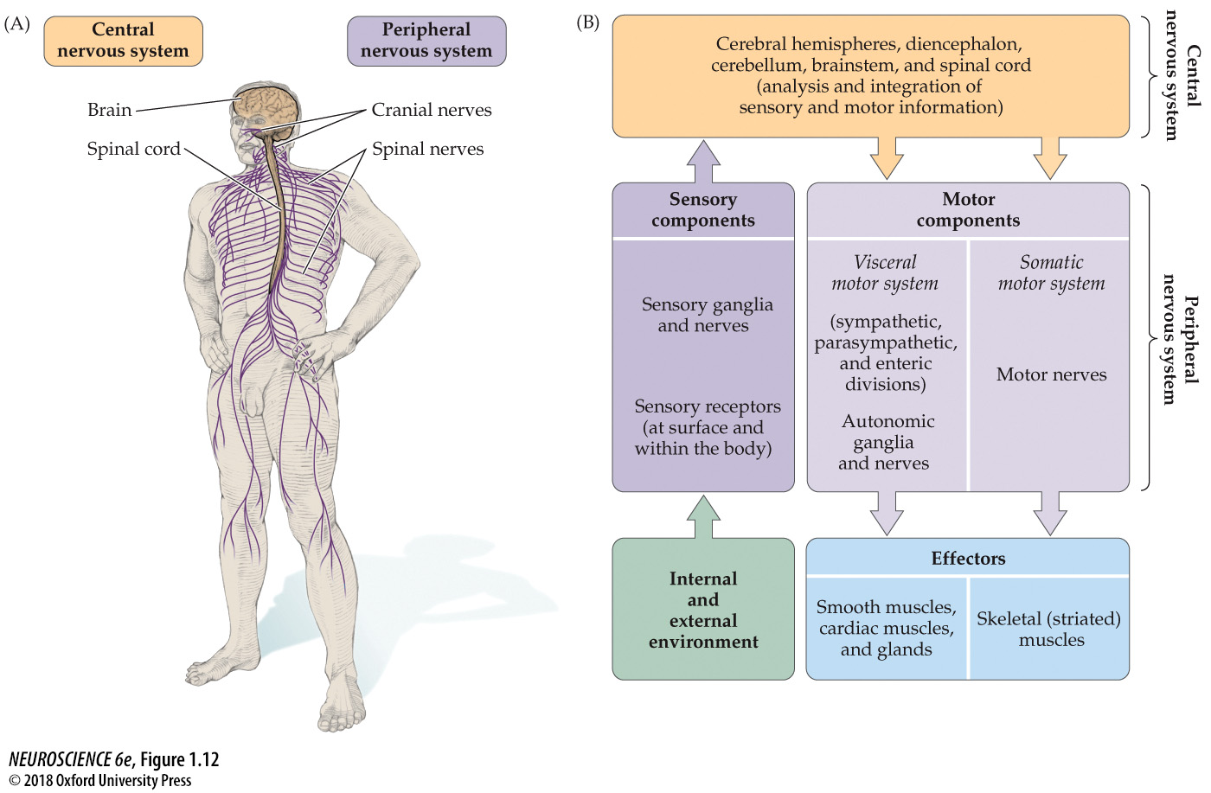
Notes:
FIGURE 1.12 The major anatomical components of the nervous system and their functional relationships. (A) The CNS (brain and spinal cord) and PNS (spinal and cranial nerves). (B) Diagram of the major components of the CNS and PNS and their functional relationships. Stimuli from the environment convey information to processing circuits in the brain and spinal cord, which in turn interpret their significance and send signals to peripheral effectors that move the body and adjust the workings of its internal organs.

Slide 18
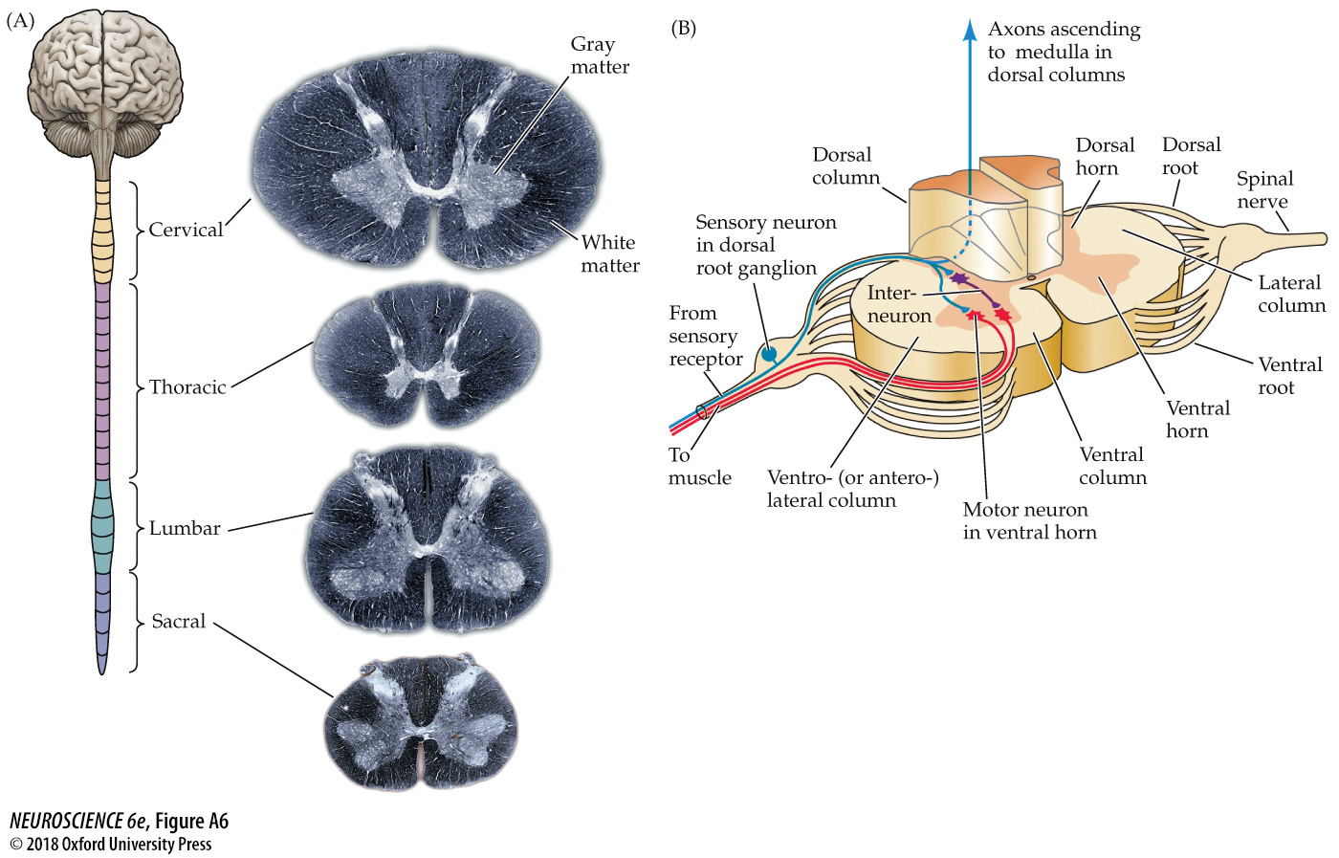
Notes:
FIGURE A6 Internal structure of the spinal cord. (A) Transverse histological sections of the cord at four different levels, showing the characteristic arrangement of gray matter and white matter in the cervical, thoracic, lumbar, and sacral regions. The sections were processed to simulate myelin staining; thus, white matter appears darker, and gray matter lighter. (B) Diagram of the internal structure of the spinal cord.

Slide 19
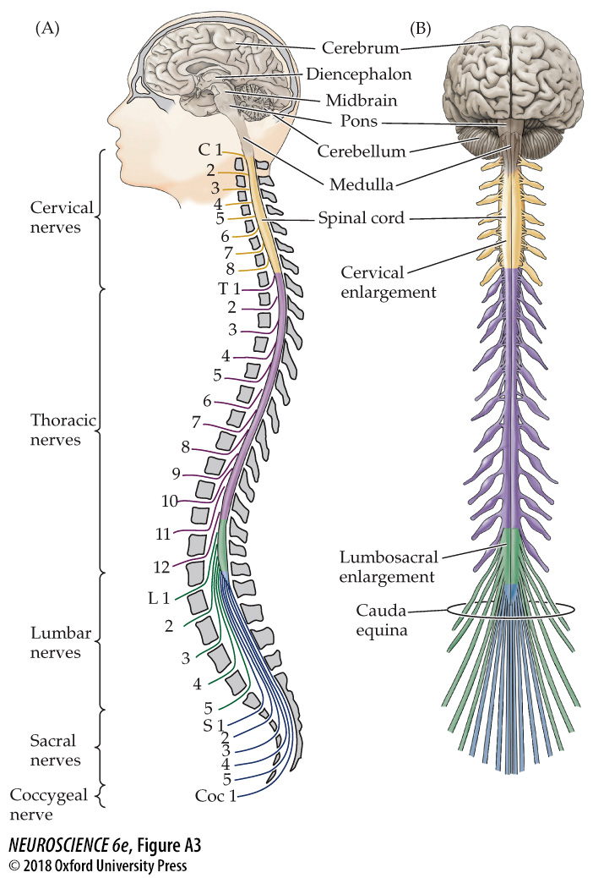
Notes:
FIGURE A3 Subdivisions and components of the central nervous system. (A) A lateral view indicating the major subdivisions and components of the CNS. (Note that the position of the brackets on the left side of the figure refers to the location of the spinal nerves as they exit the intervertebral foramina, not the position of the corresponding spinal cord segments.) (B) The CNS in ventral view, indicating the emergence of the spinal nerves, the cervical and lumbar enlargements, and the cauda equina.

Slide 20
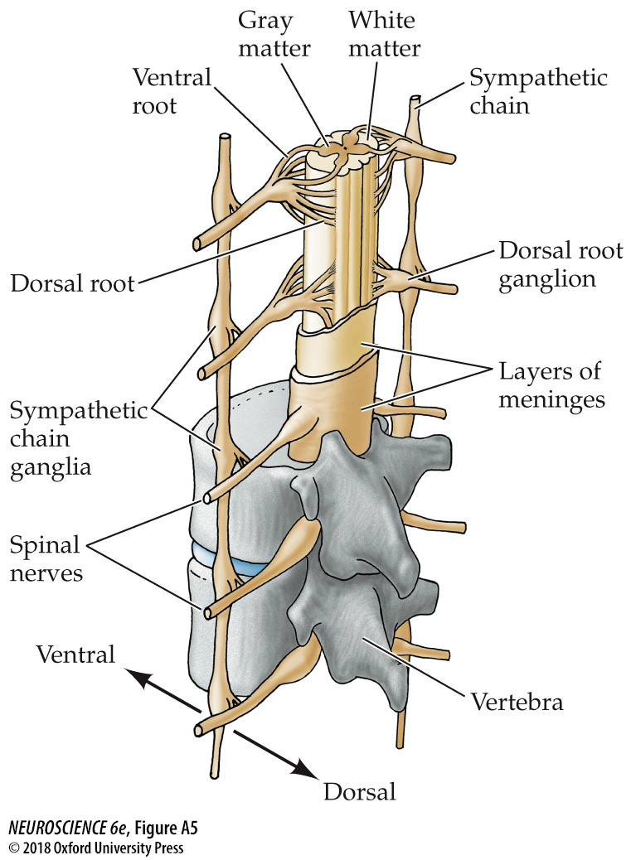
Notes:
FIGURE A5 Relationship of the spinal cord and spinal nerves in the vertebral column. Sensory information carried by the spinal nerves enters the cord via the dorsal roots of ganglia; motor commands leave the cord via the ventral roots. Once the dorsal and ventral roots join, sensory and motor axons usually travel together in the spinal nerves.

Slide 21
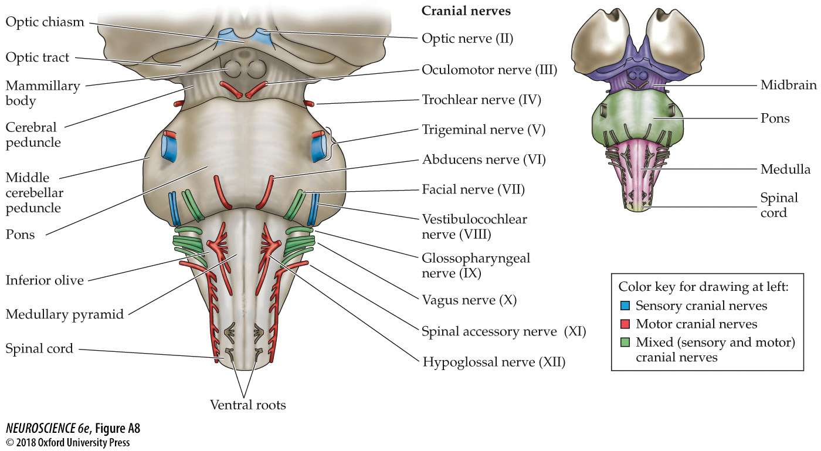
Cranial nerves of the brainstem
Notes:
FIGURE A8 Cranial nerves of the brainstem. This ventral view of the brainstem shows the locations of the cranial nerves as they enter or exit each of the brainstem subdivisions (midbrain, pons, and medulla, shown at the right).

Slide 22
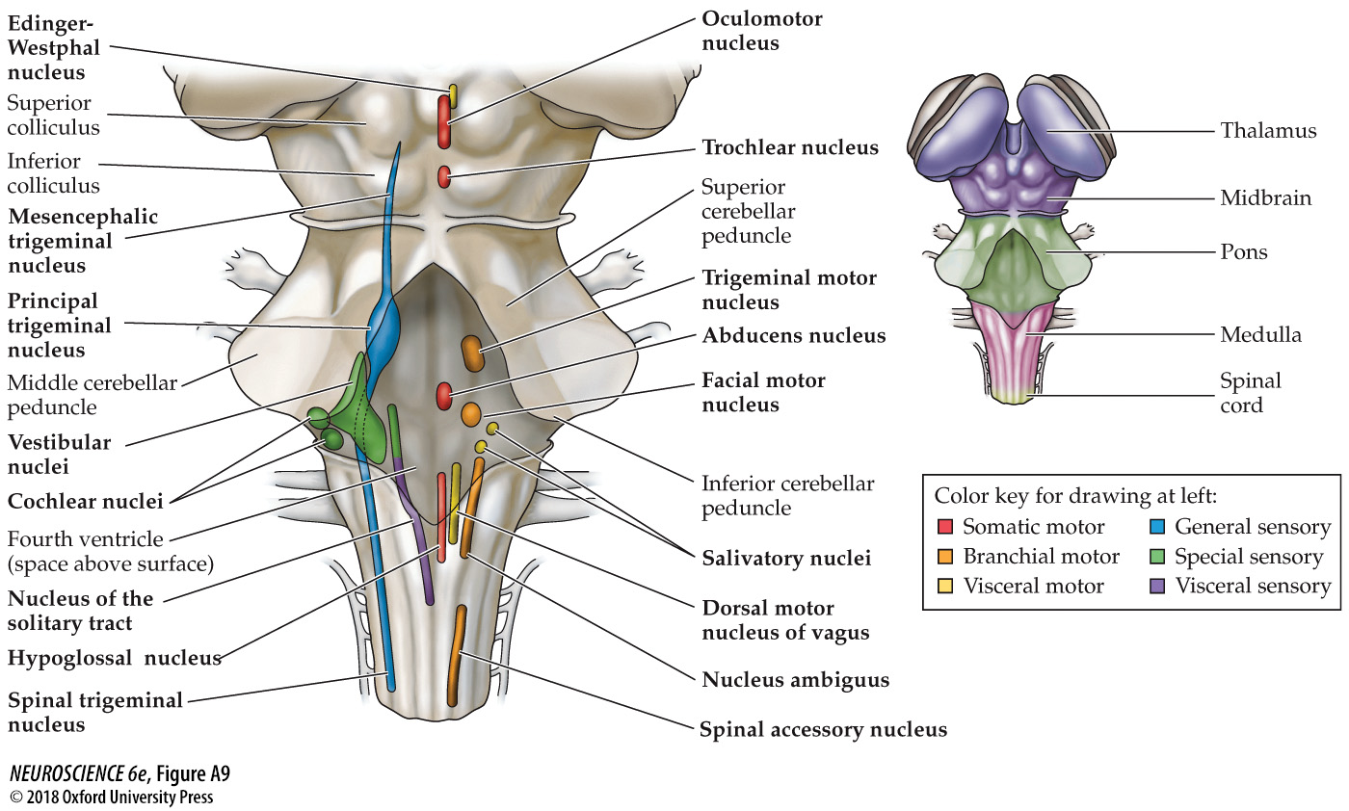
Cranial nerve nuclei of the brainstem
Notes:
FIGURE A9 Cranial nerve nuclei of the brainstem. This “phantom” view of the brainstem’s dorsal surface shows the locations of the brainstem nuclei that are either the target or the source of the cranial nerves. (See Table A2 for the relationship between each cranial nerve and cranial nerve nuclei, and Table A3 for a functional scheme that localizes cranial nerve nuclei with respect to brainstem subdivision and sensory or motor function.) With the exception of the nuclei associated with the trigeminal nerve, there is close correspondence between the location of the cranial nerve nuclei in the midbrain, pons, and medulla and the location of the associated cranial nerves. At right, the territories of the major brainstem subdivisions are indicated on the dorsal surface.

Slide 23
Terminology
Ganglion: Collections of hundreds to thousands of neuronal cell bodies found outside the CNS along the course of peripheral nerves
Nucleus: Collections of hundreds to thousands of neuronal cell bodies found inside the CNS

Slide 24
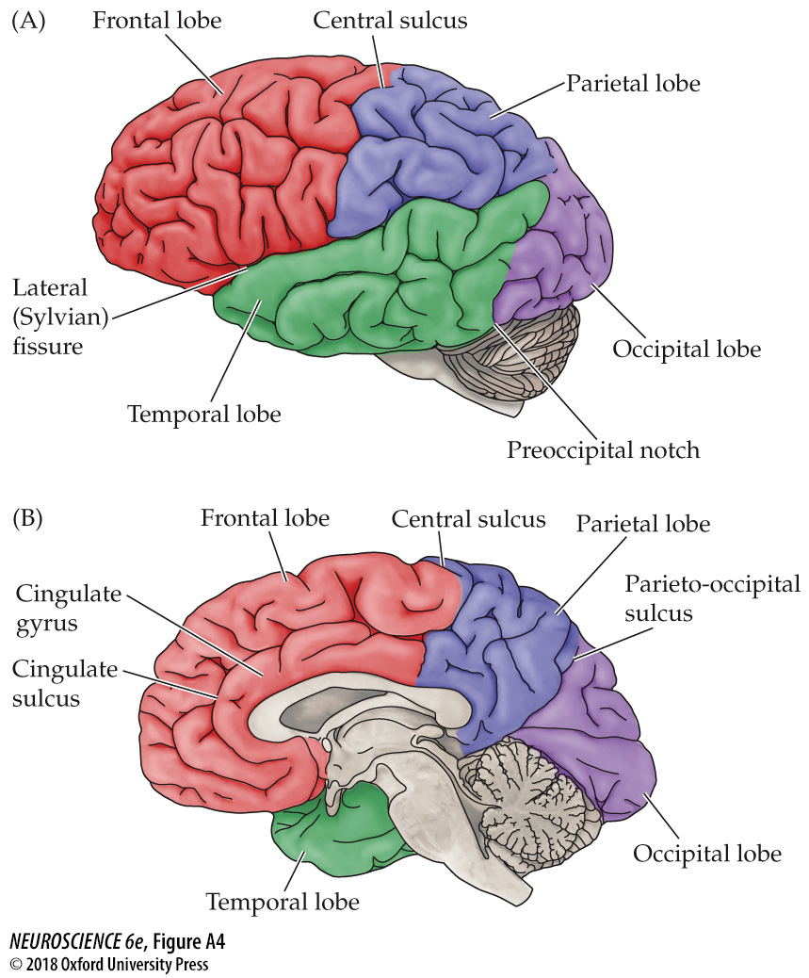
Notes:
FIGURE A4 Surface anatomy of the cerebral hemisphere. These depictions show the four lobes of the brain and the major fissures and sulci that help define their boundaries. (A) Lateral view. (B) Midsagittal view.

Slide 25
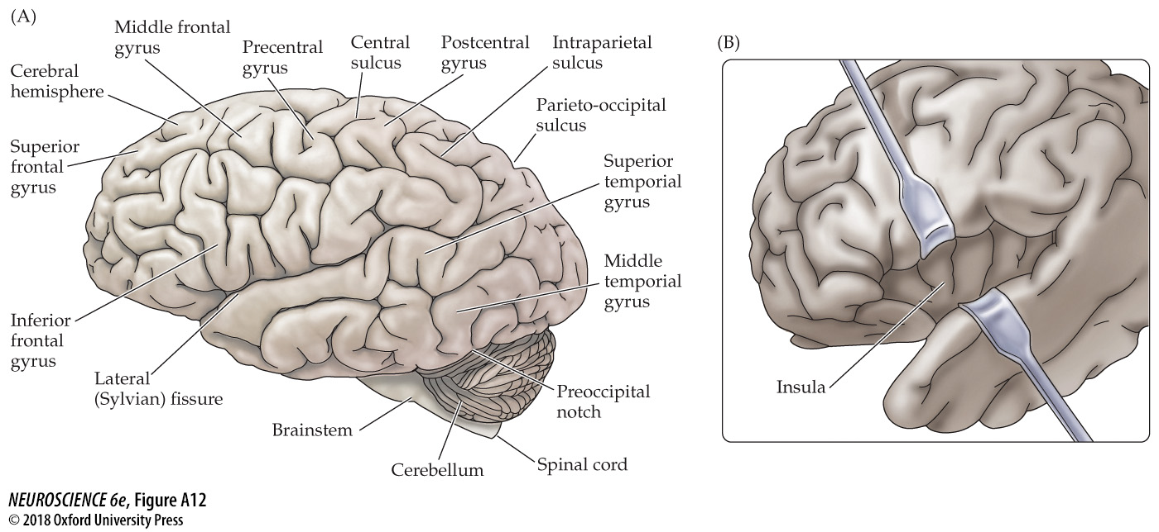
Notes:
FIGURE A12 Lateral view of the human brain. (A) Illustration of some of the major gyri and sulci from this perspective. (B) The banks of the lateral (Sylvian) fissure have been pulled apart to expose the insula.

Slide 26
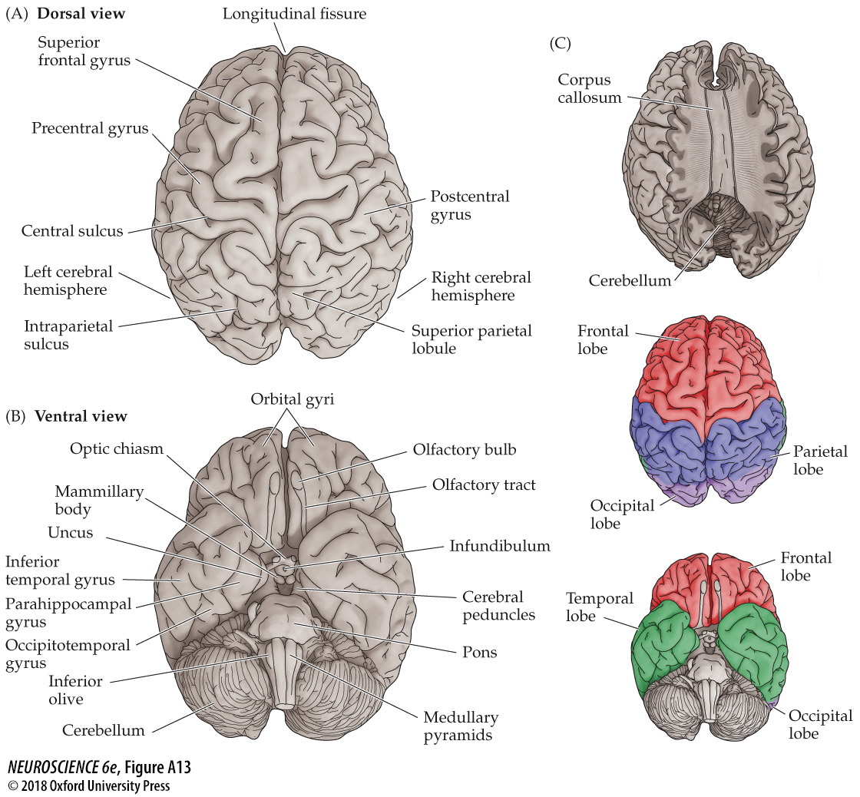
Notes:
FIGURE A13 Dorsal and ventral views of the human brain. (A) Dorsal view. (B) Ventral view. Both views indicate some of the major features visible from these perspectives. (C) In the upper image (dorsal view), the cerebral cortex has been removed to reveal the underlying corpus callosum. The two lower images highlight the four lobes of the cerebral cortex. (C from Rohen et al., 1993.)

Slide 27
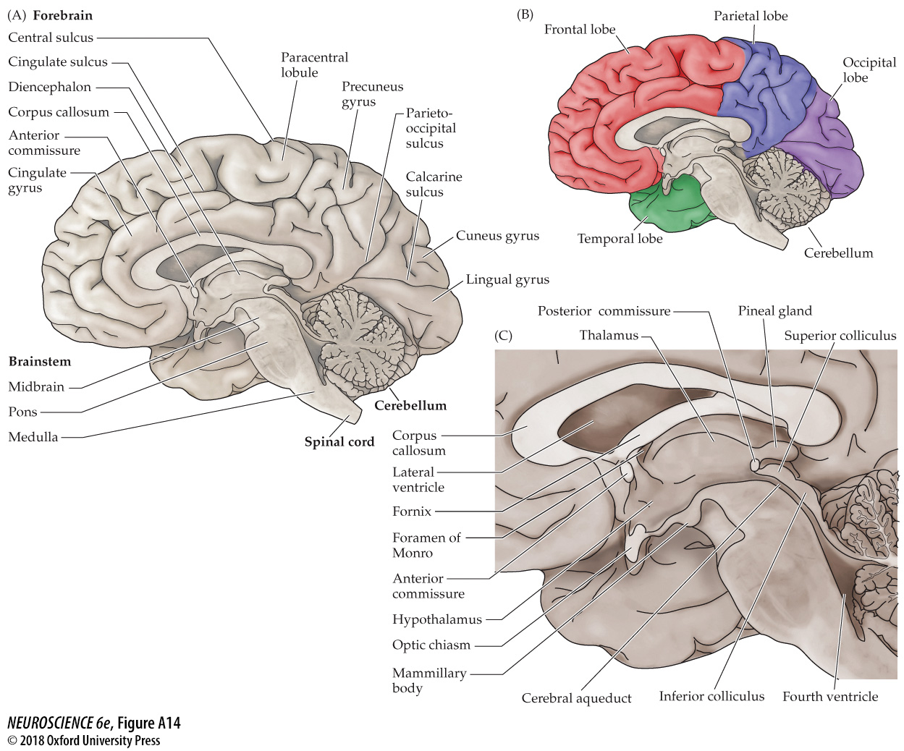
Notes:
FIGURE A14 Midsagittal view of the human brain. (A) Major features apparent after bisecting the brain in this plane. (B) Lobes of the brain seen from its medial surface. (C) An enlarged view of the diencephalic region and brainstem.

Slide 28
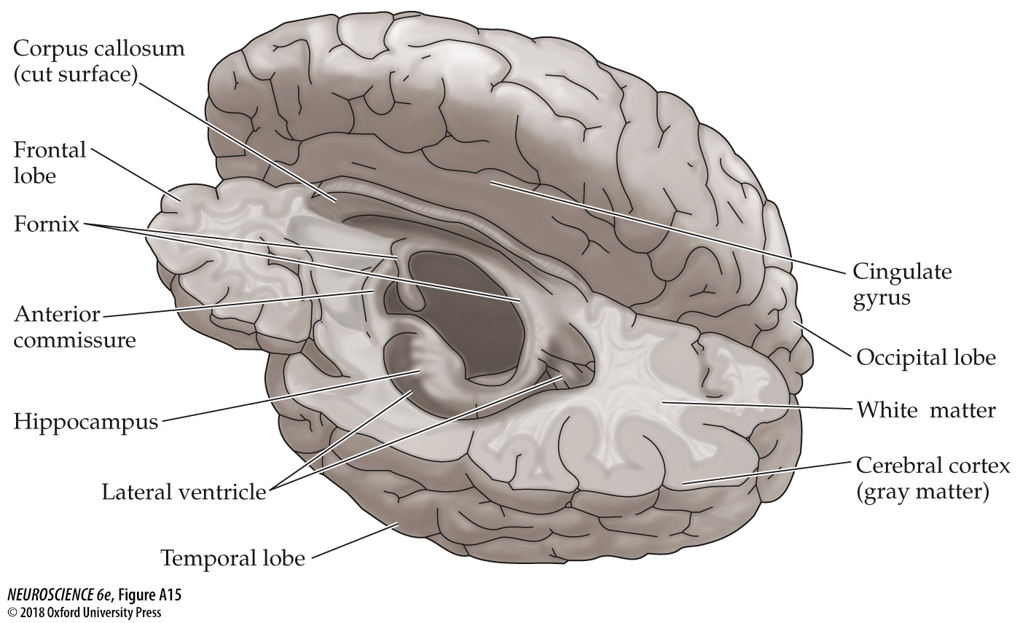
Notes:
FIGURE A15 Major internal structures of the brain. In this view, the upper half of the left hemisphere has been dissected away, revealing the temporal horn of the lateral ventricle, the hippocampus, and the fornix.

Slide 29
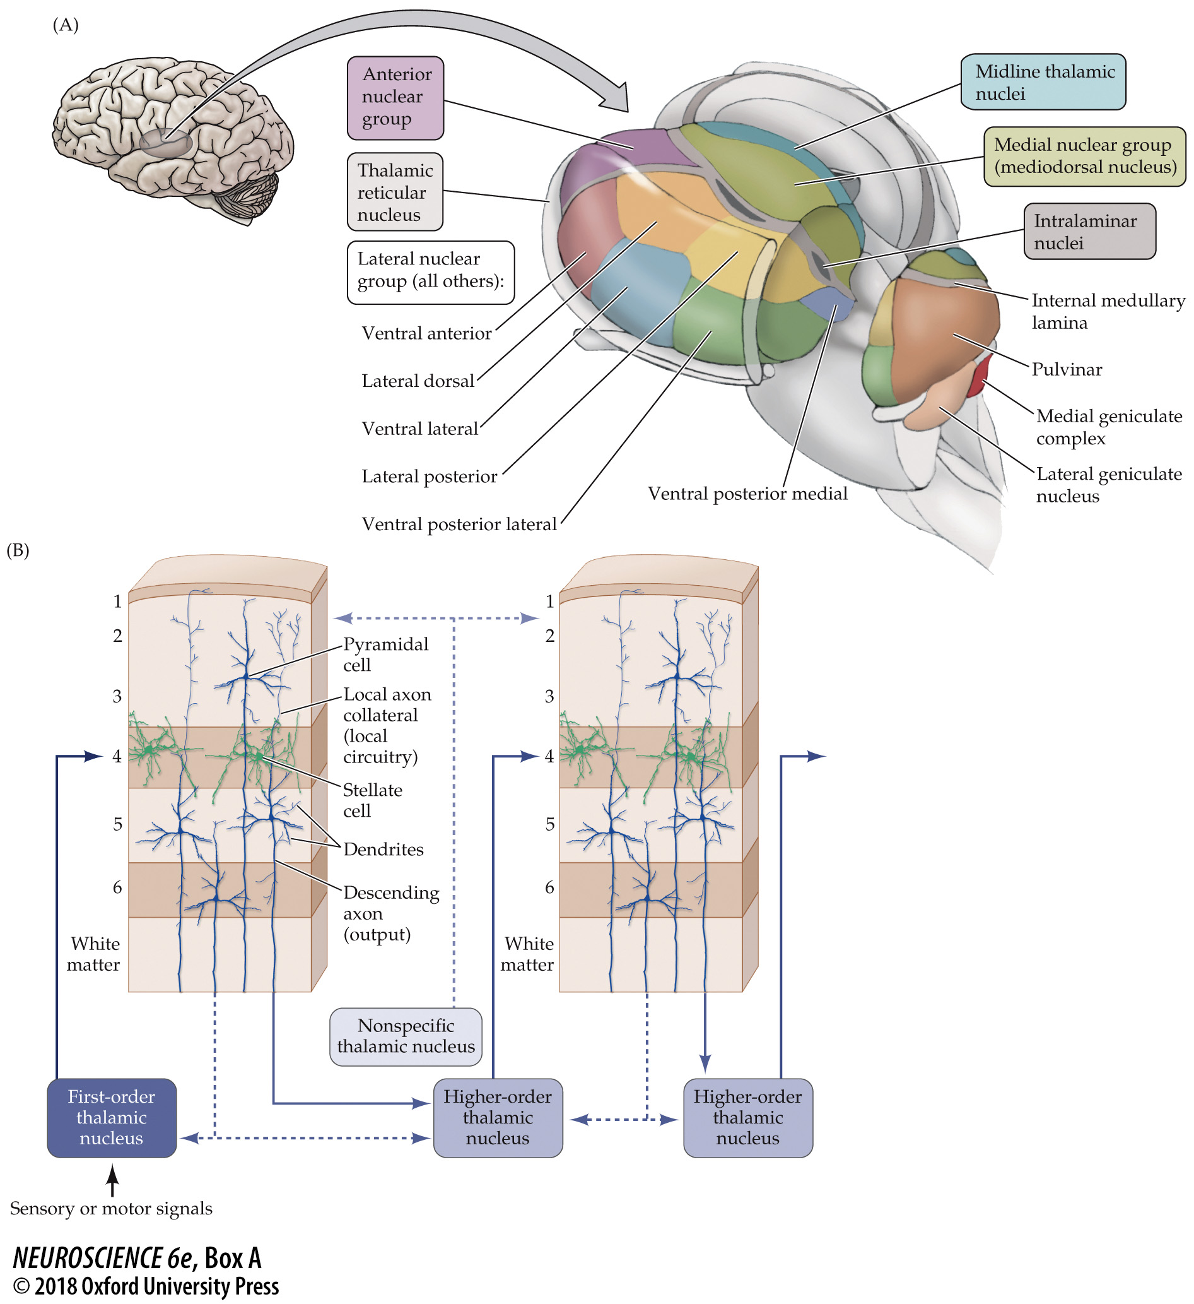
Notes:
BOX A Thalamus and Thalamocortical Relations (A) Subdivisions of the thalamus in the human brain. (From Blumenfeld, 2010.) (B) Thalamocortical relations. Some specific thalamic nuclei are “first-order” relays of sensory or motor signals to the middle layers of primary cortex; other, “higher-order” nuclei distribute output signals via cortico-thalamocortical circuits (solid arrows). The thalamus also receives and distributes modulatory signals (dashed lines). (After Sherman and Guillery, 2011.)

Slide 30
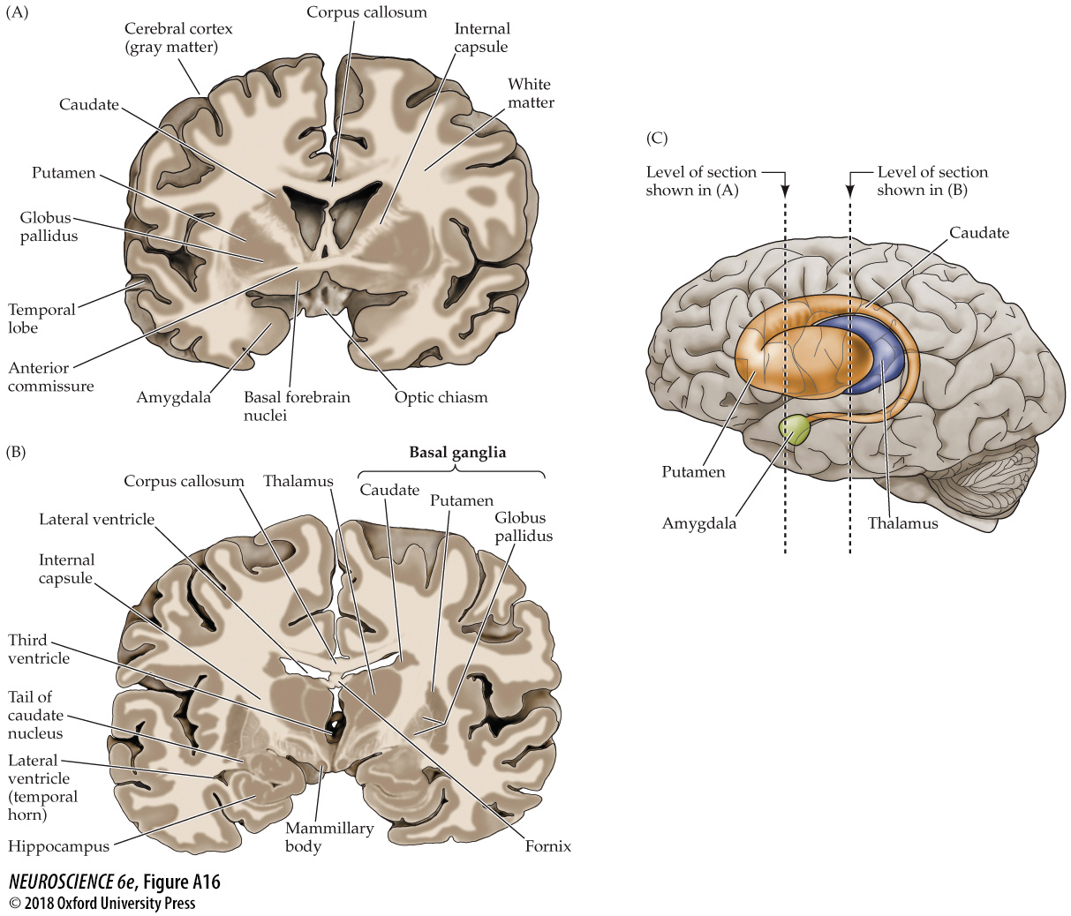
Notes:
FIGURE A16 Internal structures of the brain seen in coronal section. (A) This section passes through the basal ganglia. (B) A more posterior section also includes the thalamus. (C) A transparent view of the cerebral hemisphere showing the approximate locations of the sections in (A) and (B) relative to deep gray matter (the basal ganglia, thalamus, and amygdala are represented). Notice that because the caudate nucleus has a “tail” that arcs into the temporal lobe, it appears twice in section (B); the same is true of other brain structures, including the lateral ventricle. (Also see Figure A20 and Atlas Plate 2.) (After Blumenfeld, 2010.)

Slide 31
Divisions of the CNS
Cerebrum
cerebral hemispheres, basal ganglia, etc.
Diencephalon
Thalamus, hypothalamus, retina, etc.
Midbrain
Inferior and superior colliculi, etc.
Pons
Cerebellum
Medulla
Spinal cord

Slide 32
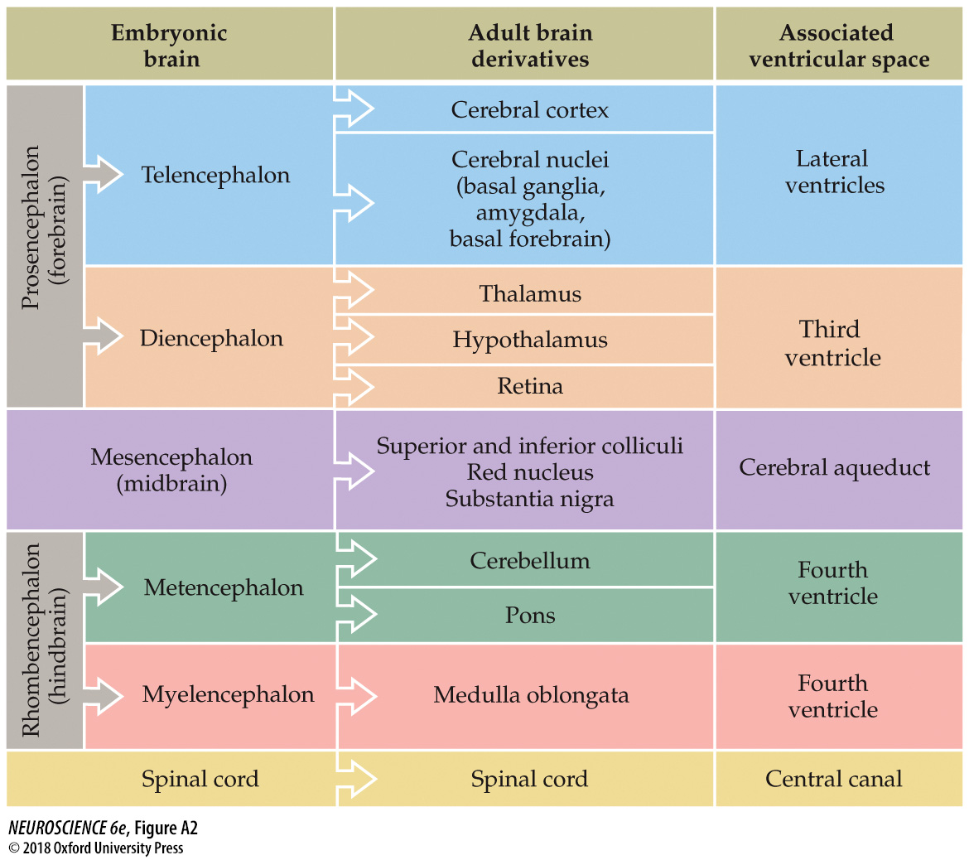
Notes:
FIGURE A2 Representative relationships between the embryonic and adult forms of the central nervous system. See Chapter 22 for an account of brain development that more fully explains the formation of regional identity in the developing CNS, including the origin of the ventricular spaces.

Slide 33
Recap
CNS, PNS, Cranial nerves, Spinal nerves
Cerebrum (Cerebral hemispheres), Diencephalon, Cerebellum, Brainstem (Midbrain, Pons, Medulla), Spinal Cord
Cervical nerves, Thoracic Nerves, Lumbar Nerves, Sacral Nerves, Coccygeal Nerves
Gray Matter, White Matter
Dorsal, Ventral, Anterior, Posterior, Caudal, Rostral, Inferior, Superior, Coronal, Horizontal, Sagittal, Transverse

